Slide 1

A Decision Support System for Real-Time Patient Monitoring in Hospitals
WS25 DECİSİON SUPPORT SYSTEM
HASAN KOSKA
MUHAMMED OSMAN OZDEN
DEEP DADASAHEP ADHAV
Supervised by
Muhammad Asim Khawaja
MSc Data Science
March 2026
University of Europe for Applied Sciences

Slide 2

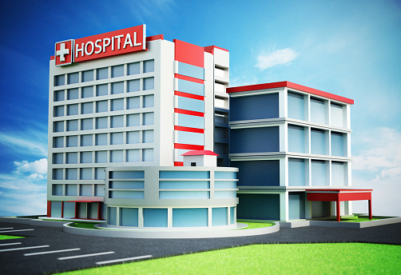

A Decision Support System for Real-Time Patient Monitoring in Hospitals
In this project, we aim to support clinical monitoring and evaluation processes using patient data.

Slide 3

Introduction
Modern hospitals generate large amounts of patient data from patient monitoring systems.
However, processing, evaluating, and comparing this data in real time is a complex task.
Healthcare professionals may overlook critical changes due to workload and inattention.
The decision support systems used here can interpret and evaluate raw data to make meaningful assessments.

Slide 4
Problem Defınıtıon
In hospital settings, patients' conditions can change rapidly and instantly. Failure to intervene quickly in such situations can lead to unpredictable consequences.
Doctors and nurses cannot monitor all patients simulltaneously in real-time. Therefore, they check on them at specific intervals.
Failure to recognize these critical situational changes in time can have serious consequences.
Therefore, there is a serious need for intelligent monitoring and support systems.

Slide 5
DSS PERSPECTIVE
This project is designed as a decision support system, not an automation system.
It is also designed in such a way that its scope can be expanded in the future to make it even more useful.
The aim of this project is to support doctors by providing them with structured and understandable insights.
The system does not make decisions for the individual; it empowers them during the decision-making process.

Slide 6
System overvıew
The system continuously monitors the specified vital data in real time.
By processing the collected data, it dynamically assesses the patient's risk status and provides feedback.
The results are presented visually to facilitate quick recognition and decision-making.

Slide 7
System archıtecture
The system was designed with a layered architecture in mind.
The database layer stores patient data and data obtained from sensors.
At the data processing layer, real-time data is analyzed and the risk level is calculated based on predetermined values.
The results obtained at the interface layer are presented to the user in an instantly understandable way.

Slide 8
Data flow
Patient data is collected in real-time and recorded in the database.
The system periodically retrieves and processes the recorded data.
The risk level is calculated according to established rules.
The results are displayed to the user in the user interface. Status information is also supported with some color coding.

Slide 9
Data descrıptıon
The datasets contain information including the patient's personal details and vital signs.
The main parameters are pulse rate, saturation, temperature, and blood pressure.
Patient records are related to time-based measurements.

Slide 10
Data processıng
Raw data is collected before analysis. It then undergoes validation and cleaning.
Incomplete and inconsistent data are carefully examined.
Data prepared in this way ensures the system operates securely.

Slide 11
Rısk defınıtıon
Risk values ​​are defined according to medical thresholds and clinical logic.
For example, low oxygen levels indicate a high priority, high risk.
An abnormal pulse or fever indicates a potential danger.

Slide 12
Rısk levels
Patients are categorized into three risk levels: normal, warning, and critical.
Each level has its own color code for quick identification.

Slide 13
Decısıon logıc
This system uses rule-based decision-making logic for transparency.
The defined threshold values ​​determine different risk levels.
With this approach, we aim to increase clarity and trust.

Slide 14

User ınterfaces
The system user interface was developed using Python Tkinter.
It displays patient data in real time, categorized according to risk levels.
Color coding allows staff to quickly interpret and identify information.

Slide 15
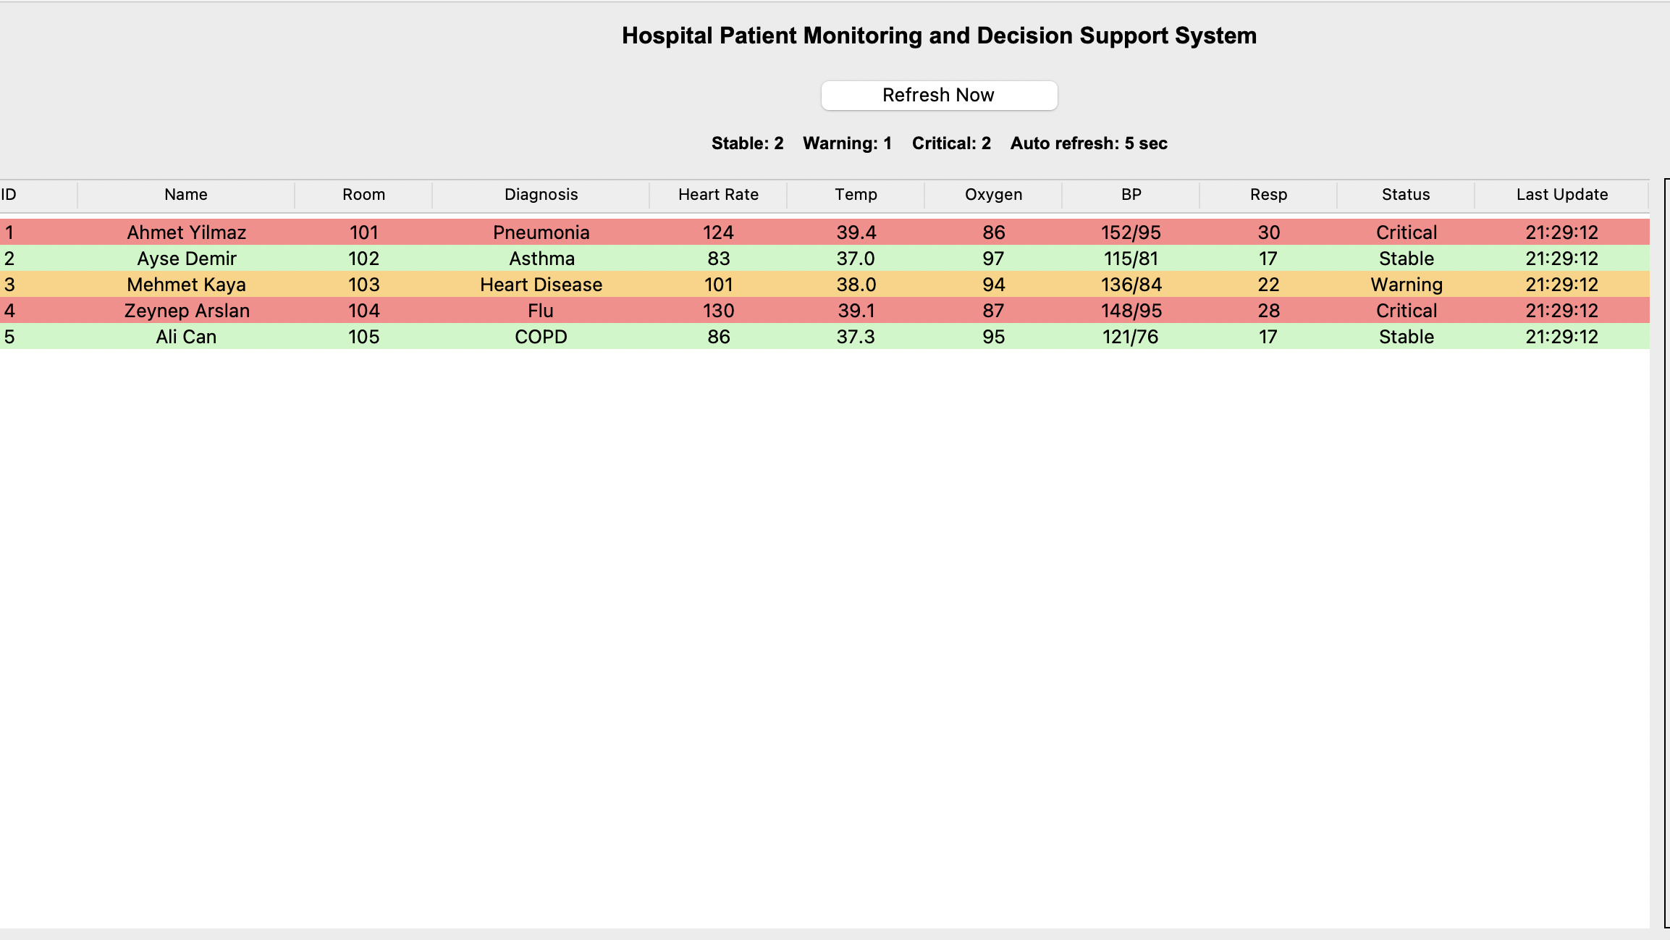
Example patıent case
For example, as shown in the figure, a patient with low oxygen levels is classified as critically ill.
The system receives this information instantly, processes it, and informs the user.

Slide 16
Future work
In the next development phase, the patient's medical history will also be included in the system.
Thresholds specific to the individual's condition will be used for more accurate assessment.

Slide 17
ADVANCED DECISION SUPPORT
The system will perform a personalized risk assessment.
It will not only identify risks but also explain their causes.
With this study, we aim to increase safety and usability in a clinical setting.

Slide 18
benefıts
It enables faster and more accurate decision-making.
It offers the possibility of continuous monitoring without interruption.
Increased patient safety and early intervention.

Slide 19
lımıtatıons
System quality depends on data quality.
Rule-based systems are limited.
Advanced models require more data and validation.

Slide 20
ConclusIon
This system transforms patient data into actionable insights.
It helps doctors make faster and better decisions.
This is a step in the right direction in smart healthcare systems.
QUESTIONS & DISCUSSION

